Slide 1
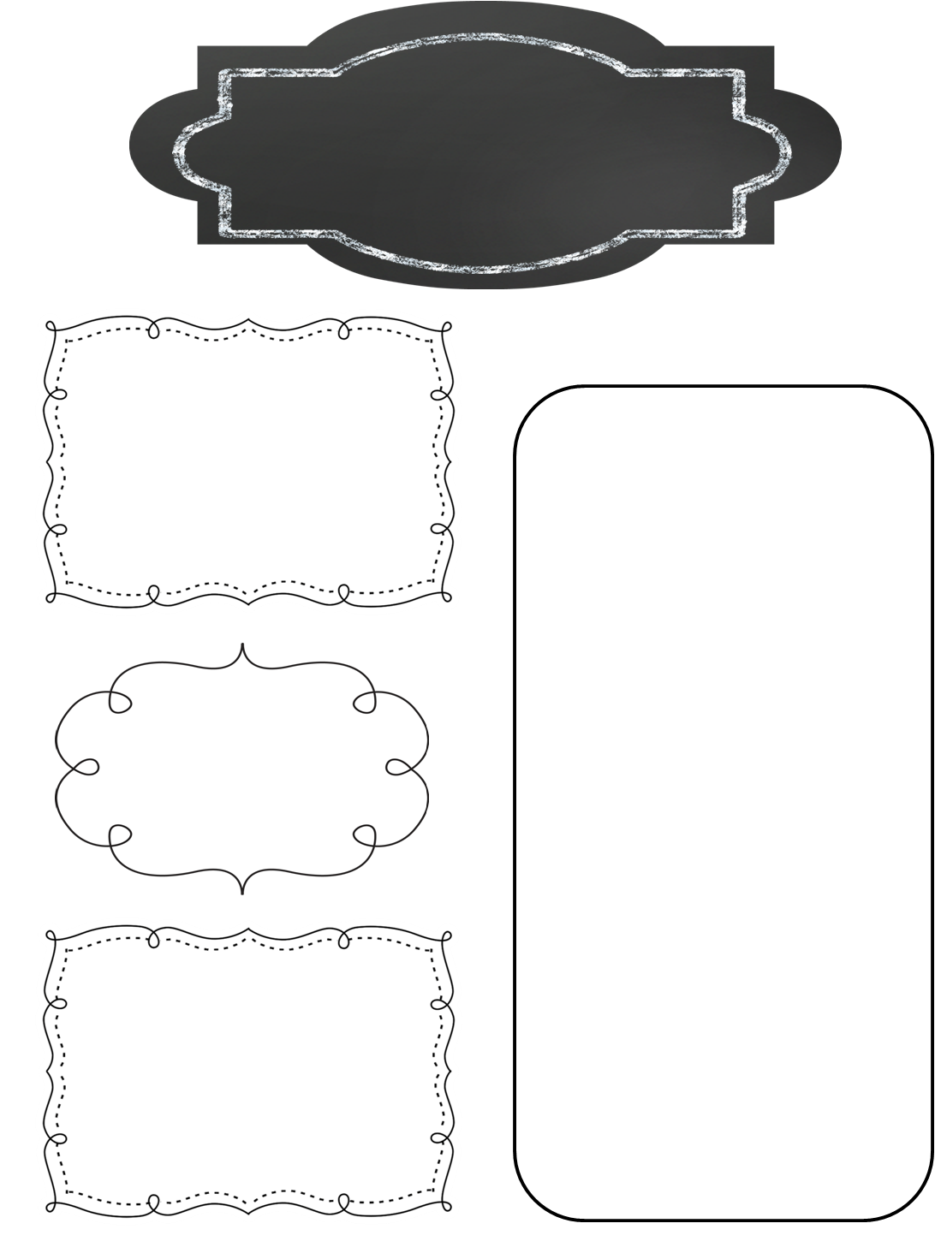
A Peek at This Week in…
Mrs. McFarland’s Class
Week of February 18th
Reminders
We have switched to a 7 day schedule for our reading units. This is in an effort to get in more daily writing. Please consult the online assignment page, your child’s agenda, or this weekly newsletter for information on reading/language/spelling test days. Tests days may not be Fridays.
Math (McFarland)
Begin Ch. 8—Fractions
Fractions as division
Simplifying fractions
Reading (McFarland)
Unit 3, L#13 (See the attached skills & strategies sheets for the unit.)
Tests next Thursday!!
Hall of Presidents and our Valentines card exchange is rescheduled for this Friday, February 21st. Hall of Presidents will take place from 8:30-10:30a. We will exchange Valentines after lunch and watch National Treasure. Students may bring a snack and drink—NO SODA!
Spelling (McFarland)
VCCCV pattern
Test next Wednesday
Language Arts/Writing (McFarland)
Upcoming Events
Regular and Irregular Verbs
Daily Proofreading
Persuasive Letter—Business style format
Wednesday, February 19th: Progress reports ready (online)
Thursday, February 20th: Manners Meal (rescheduled)
Friday, February 21st: Hall of Presidents (8:30-10:30), Valentine’s Day card exchange
Monday, March 2nd: Yearbook orders are due
Thursday, March 5th: Math & Science Night 6:00-7:15p
Science/ Social Studies (Eldridge)
Science: N/A
Social Studies: Ch. 9, L#1 & 2; Practice Hall of Presidents speeches; make sure you have your outfit lined up for HoP AND your prop!!

